Slide 1

`
Green Energy Sources : Wind Energy in Taiwan and Companies Towards Sustainable Development
Presenter: Ashish Kumar
Student ID: 108998404
Instructor: Prof. Sangeetha Thangavel

Slide 2
CONTENTS
Green Energy Sources: Wind Energy
Wind Turbine Parts
Size and Power of Wind Turbine
Goal of Wind Energy
Pros and Cons of Wind Energy
Wind Energy In Taiwan
Timeline: Growth of Wind Energy In Taiwan
Types of Wind Farms
Offshore Wind Farms In Taiwan
Wind Farms Projects In Taiwan
Power Capacity and Generation in Taiwan
Companies Towards Sustainable Development

Slide 3
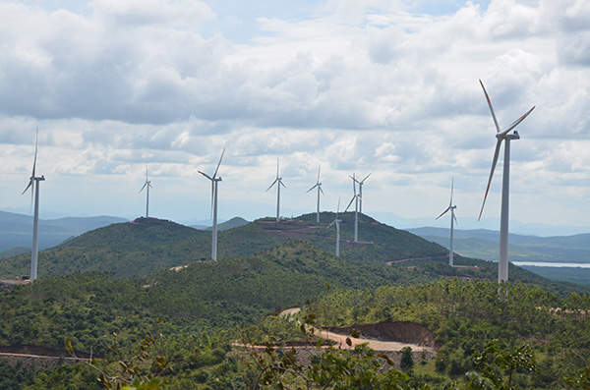
Green Energy Sources: Wind Energy
A renewable energy source means energy that is sustainable - something that can't run out, or is endless, like the sun.
Wind is a plentiful source of clean energy.
To harness electricity from wind energy turbines are used.
Wind turbines convert the kinetic energy in winds into mechanical power.
Wind basically turns the blades of turbines which spins a shaft which is connected to the generator and make electricity.
Wind farms: wind turbines grouped into a single wind power plant and generates bulk electricity power.
Tuppadahalli onshore wind farm is a 56.1MW power project being built in Karnataka.
Image Source: https://www.power-technology.com/projects/tuppadahalli-wind-farm/

Slide 4
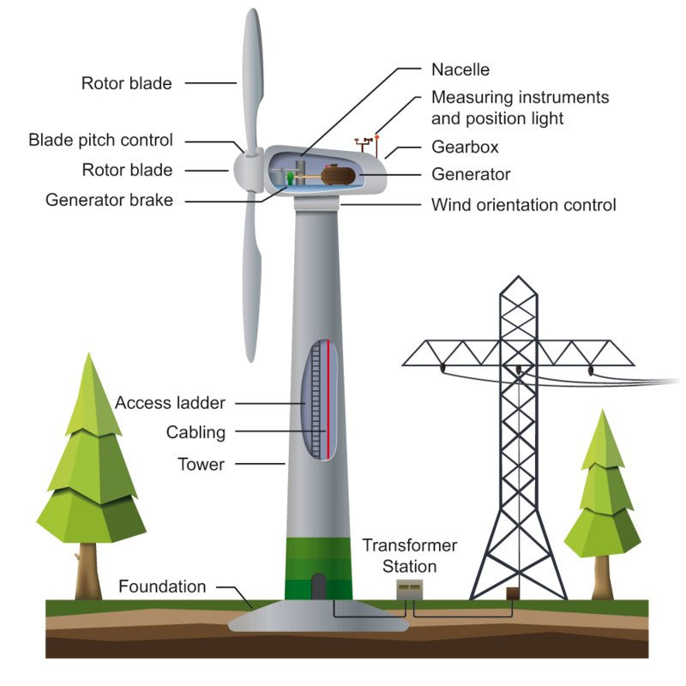
Wind Turbine Parts
Tower
Usually made of steel, hollow with a ladder inside that leads to the nacelle.
Nacelle
Usually made of fiber glass and holds all the turbine machinery.
Blades
Made from reinforced carbon fiber plastics similar to an airplane wing.
Sensors
Found in the nacelle and measure wind direction, speed and temperature.
Image Source: https://www.uka-gruppe.de/fileadmin/_processed_/d/4/csm_wind-turbine-components_1833483f26.jpg

Slide 5
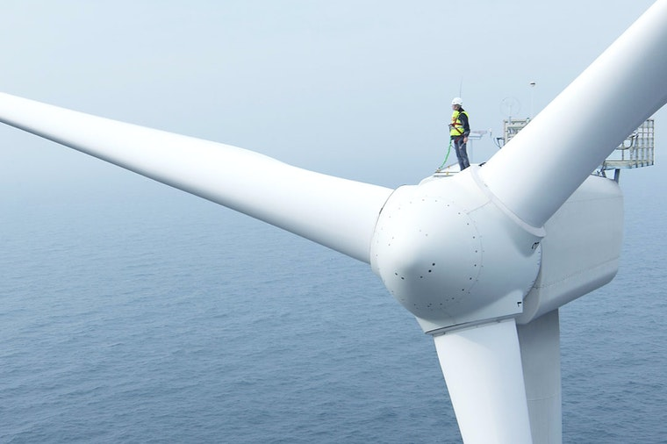
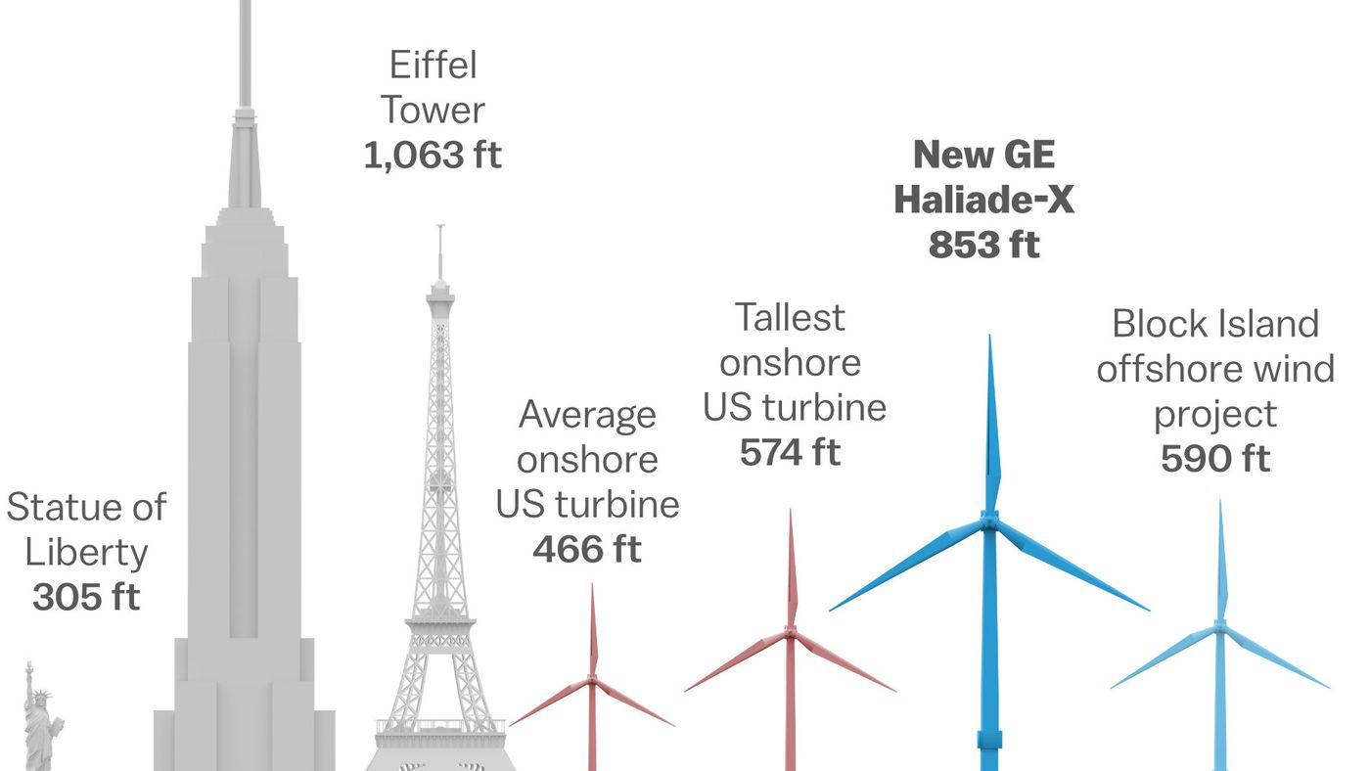
Size and Power of Wind Turbine
Wind turbines usually varies in size.
Biggest Turbines:
Up to 20 building stories high and blades are length of football field.
Capable of producing enough energy up to 1400 homes.
Smallest Turbines:
Between 8 to 25 feet in diameter and stands about 30 feet high.
Can produce power needed for electric homes.
1.
2.
Image Source: 1. https://www.iea.org/reports/offshore-wind-outlook-2019
2. https://cdn.vox-cdn.com/thumbor/DHKNqWz-kpH6Y8LzUYo9z7FCWh0=/1400x788/filters:format(jpeg)/cdn.vox-cdn.com/uploads/chorus_asset/file/10382023/Wind_turbine_heights.jpg

Slide 6

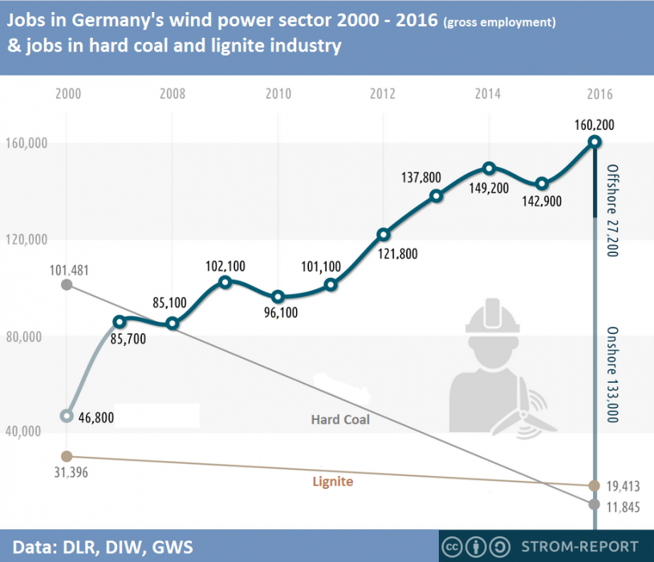
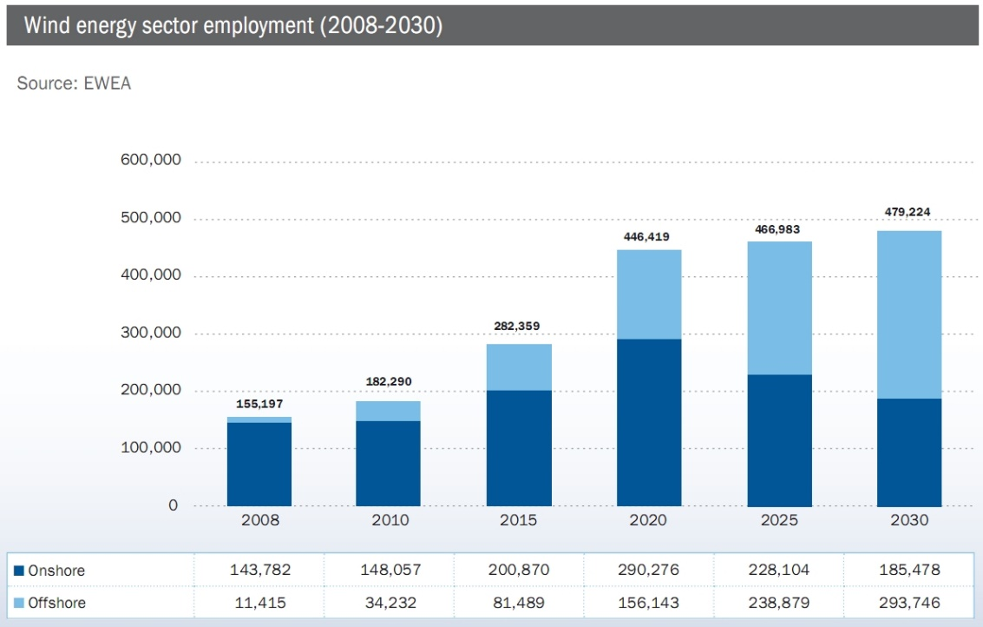
Goal of Wind Energy
Main goal of wind energy is to create sustainable energy.
Process of harvesting wind energy create jobs, economic investments and clean energy.
2
1
Image Source: 1. https://www.cleanenergywire.org/news/econ-min-altmaier-says-grid-expansion-priority-job-booster-wind/wind-power-employed-five-times-more-people-coal-germany-2016-report
2. https://interestingenergyfacts.blogspot.com/2010/10/wind-power-jobs-facts.html

Slide 7
Pros and Cons of Wind Energy
Pros
Clean & Environment friendly Fuel source: It doesn’t pollute air like power plant relying on combustion of fossil fuel.
Renewable & Sustainable: Winds are caused by heating of atmosphere by the sun, earth surface irregularities and the rotation of the earth.
Cost Effective: Wind energy is completely free.
Industrial and Domestic Installation: Wind turbines can be built on existing farms or ranches where most of the best wind sites are found.
Job Creation: Jobs have been created for the manufacture of wind turbines, the installation and maintenance of wind turbines and also in wind energy consulting.
Cons
Not a profitable use of land: Alternative uses for the land might be more highly valued than electricity generation.
Threat to wildlife: Birds have been killed by flying into spinning turbine blades.
Fluctuation of Wind and Good wind site.

Slide 8
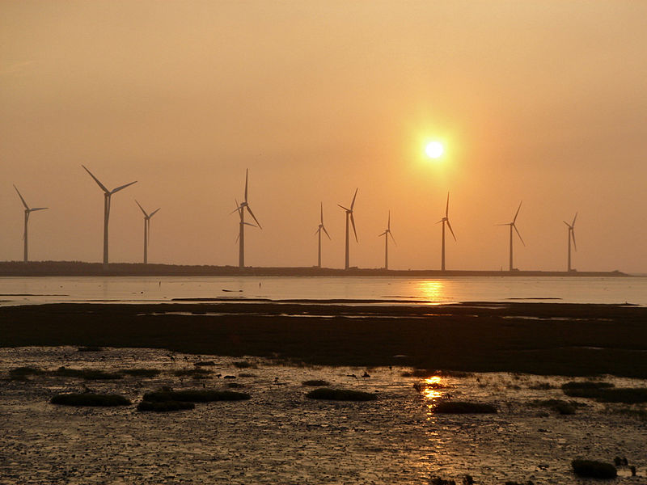
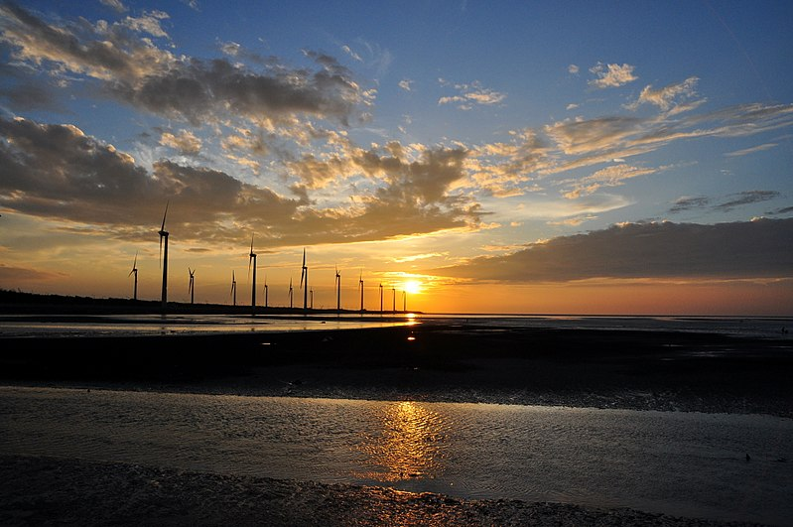
Wind Energy in Taiwan
Taiwan has abundant wind power resources.
Taiwan demonstrates both onshore and offshore wind energy.
Offshore wind energy is the use of wind farms constructed in bodies of water usually in the ocean to harvest wind energy to generate electricity.
In 2016, there were 346 installed onshore turbines in operation with the total installed capacity of 682 MW.
In 2013, Taiwan's onshore wind farm capacity factor was 28-29%, while its future offshore wind farm is 33-38%, with the total installed onshore wind capacity of 530 MW.
Currently in Taiwan 55 integrated and automated wind power forecasting systems are established in Zongtun, Kinmen, Mailiao, Changgong and Shihu.
Wetland in Qingshui District, Taichung, Taiwan.
Images Source: https://en.wikipedia.org/wiki/File:Sunset_of_Gaomei_Wetland.JPG

Slide 9
Timeline: Growth of Wind Energy in Taiwan
January 2003: First phase of wind power installation.
December 2008: 59 wind turbines were put into commercial operations in Shinmen, Tatan Unit 1 Guanyuan, Shianshan, Port of Taichung, Taichung Power Plant and Hengchun with a total installed capacity of 96.96 MW.
January 2005 until September 2011: The second phase was done in which 58 turbines were put into operation in Changgong Unit 1, Yunlin Mailiao, Sihu, Linko and Tatan Wind Power Stations.
January 2007 until July 2011: The third phase was done in which 28 turbines were put into operation in Changgong Unit 2, Yunlin Mailiao Unit 2, Changhua Wanggong and Tatan II Wind Power Stations with a total capacity of 59.6 MW.
June 2015 : The fourth phase of wind power installation completed with total capacity of wind power to be 14.8 MW, generating 43.081 GWh per year.

Slide 10
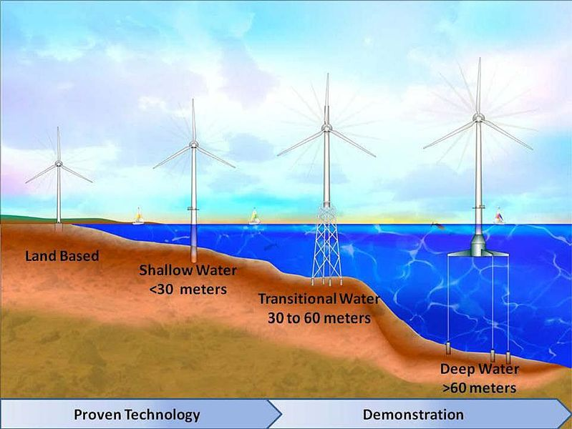
Types of Wind Farms
In Taiwan
Images Source: https://en.wikipedia.org/wiki/File:Foundations_NREL.jpg

Slide 11
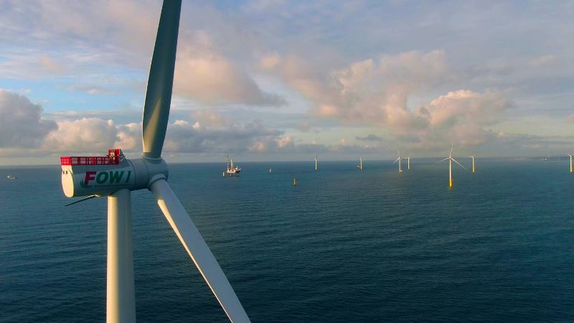
Offshore Wind Farms in Taiwan
Formosa 1 Offshore Wind Farm is the first offshore wind farm in Taiwan, started its commercial operation in April 2017 at off the coast of Miaoli County.
The development project is led by Swancor Renewable.
The firsts stage of the construction involved two 4 MW wind turbines which were installed in November 2016 with a total generation capacity of 8 MW.
The second stage of the construction was on-grid in December 2019 which involved 20 Siemens Gamesa's SWT-6.0-154 turbines with a total capacity of 120 MW.
Formosa II wind farms will be constructed also offshore Miaoli County with a planned capacity of 300-500 MW.
Formosa III wind farm will be constructed offshore Changhua County with a planned capacity of 1,900 MW.
Formosa 1 Offshore Wind Farm, Miaoli County, Taiwan
Images Source: https://www.power-technology.com/news/taiwans-formosa-1-offshore-windfarm/

Slide 12
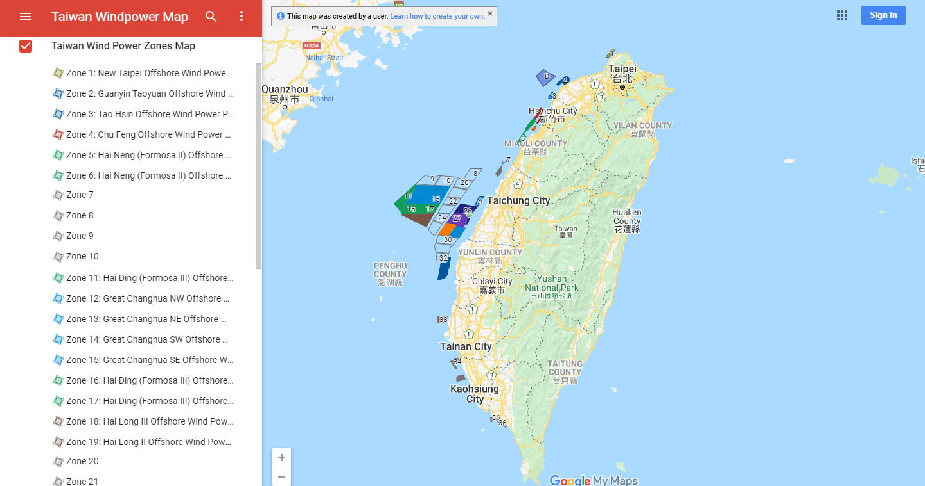
Wind Farms Projects in Taiwan

Slide 13
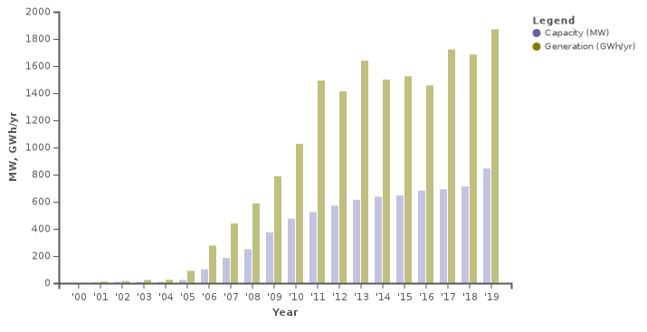
Power Capacity and Generation in Taiwan
In 2020 TSMC signed a 20-year power purchase agreement from 2026 for 920 MW.
Installed power capacity and generation in Taiwan in recent years.
Images Source: https://en.wikipedia.org/wiki/Wind_power_in_Taiwan

Slide 14
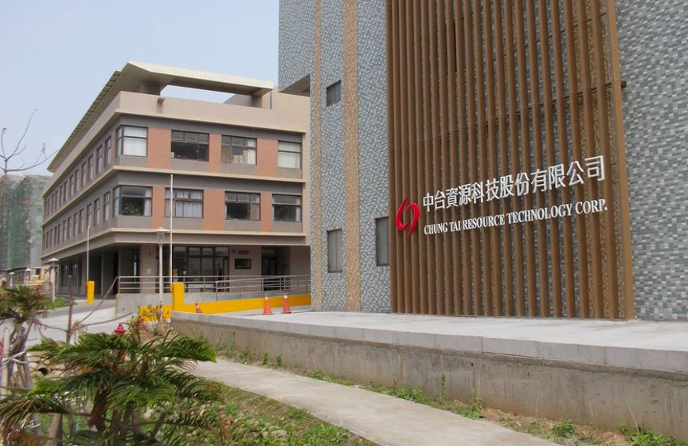
Companies Towards Sustainable Development
Chung Tai Resource Technology Corp.
The Leading Resources Company of Treating Waste Lighting in Greater China
In order to accomplish the ideal of sustainable business, Chung Tai Resource Technology Corp. has been dedicating in running mercury containing waste, waste lighting, waste PCB recycling business and green industry with a strong faith of maintaining natural environment and regenerating waste resources.
Chung Tai Corp. has formed a completed recycling cycle link with its mother company, China Electric Mfg. Corporation, from manufacturing, distributing, and retailing to waste lighting recycling.
Images Source: https://www.cpc-coegp-2020.org/

Slide 15
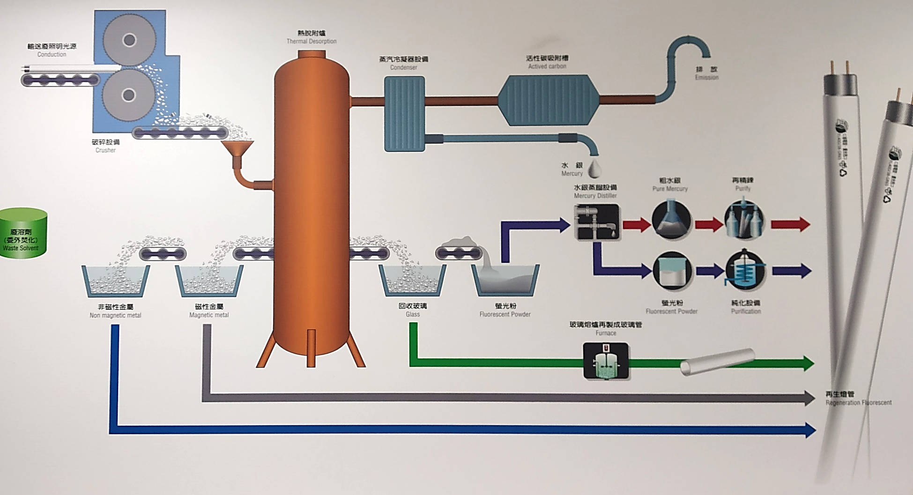
Chung Tai Resource Technology Corp.

Slide 16
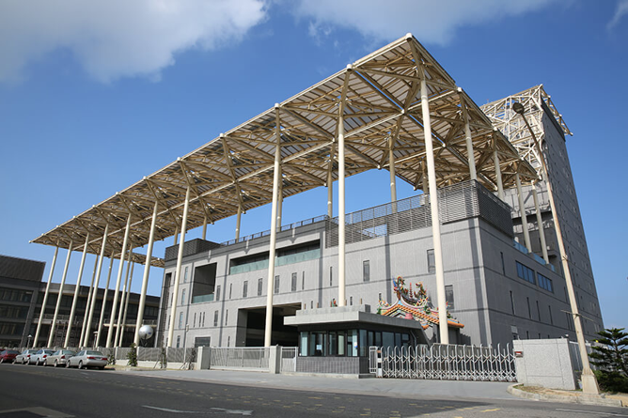
Companies Towards Sustainable Development
Super Dragon Technology Co. Ltd.
Super Dragon established a recycling and hazardous waste processing factory in Taiwan
Super Dragon Technology Co. Ltd was established in September 1996.
It introduced equipment from Germany and in August 1999 obtained permission to begin operation.
It become Taiwan's largest electronics waste resource processing factory and provided comprehensive waste removal and processing services for Taiwan's high-tech sector.
Images Source: https://www.cpc-coegp-2020.org/

Slide 17
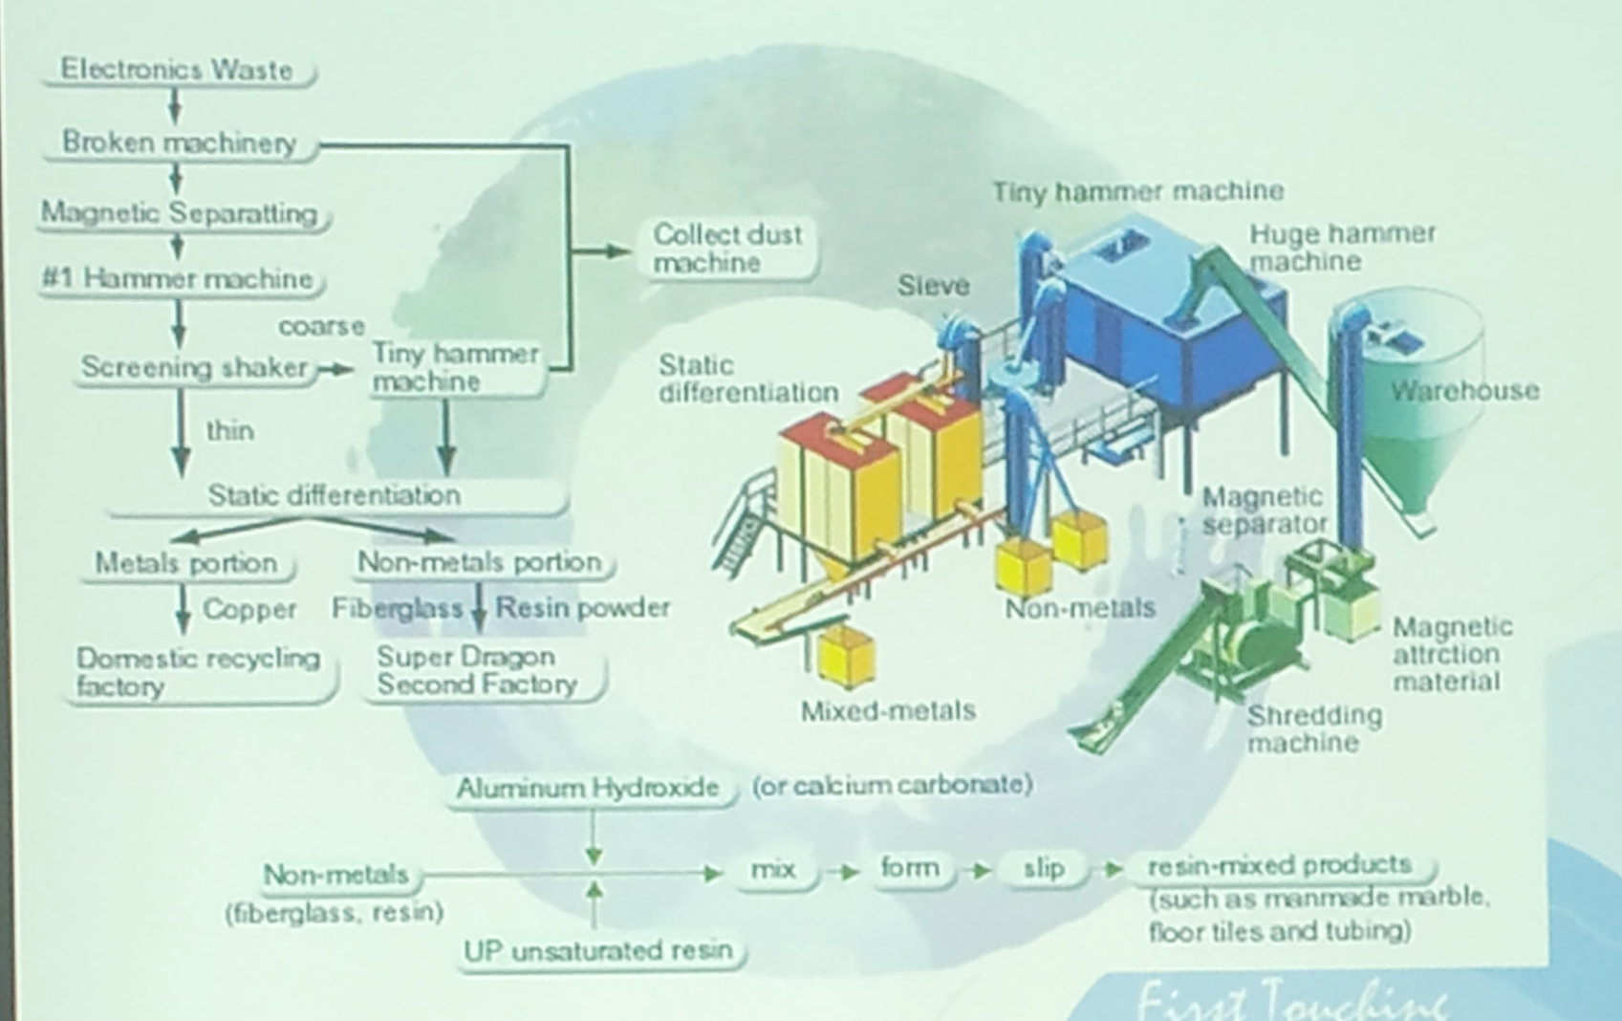
Super Dragon Technology Co. Ltd.

Slide 18
A Glimpse of My Trip

Slide 19
Thank You

